Slide 1
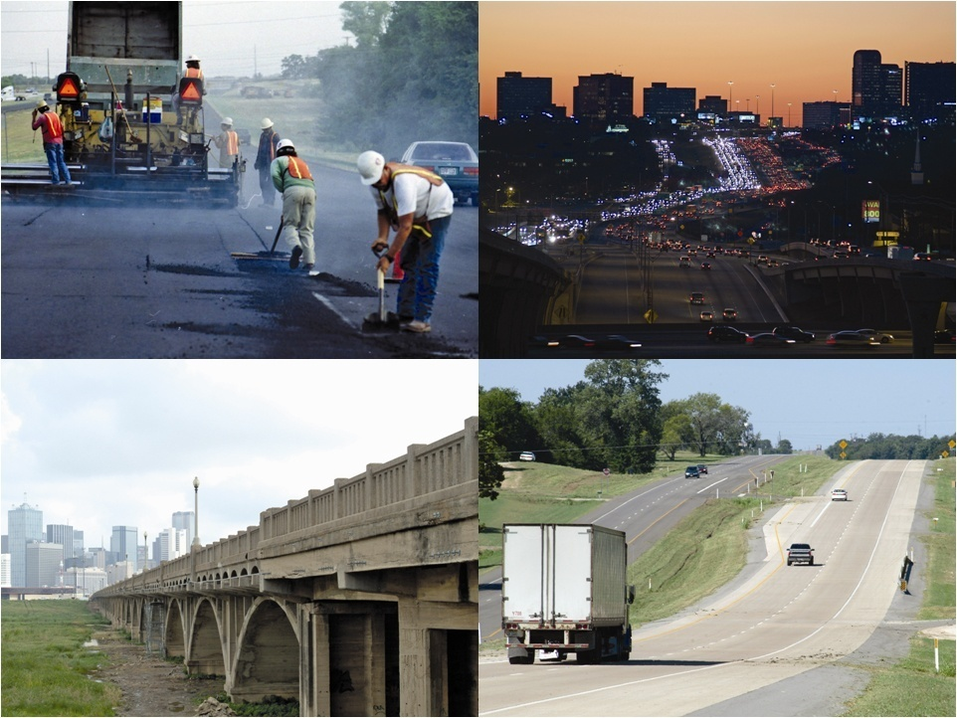

Recommendations
December 17, 2008
Draft Pending Commission Review and Public Comment

Slide 2
C. Michael Walton, Chair
Austin
David Marcus, Vice-Chair
El Paso
Ken Allen
San Antonio
Ruben Bonilla, Jr.
Corpus Christi
Drew Crutcher
Odessa
The Honorable Ed Emmett
Houston
Tom Johnson
Austin
David Laney
Dallas
Cullen Looney
Edinburg
Drayton McLane, Jr.
Temple
Roger Nober
Fort Worth
Gary Thomas
Dallas

Slide 3
Context of 2030 Study
Population growth, policy issues, high public and policy interest
Urgent need for current, independent, authoritative statewide needs assessment superseding all prior estimates
Volunteer committee – experienced, respected stakeholders guiding independent research
Public hearings - solicit citizen input
Funding available, even with new sources, will not be adequate to address all identified transportation needs

Slide 4
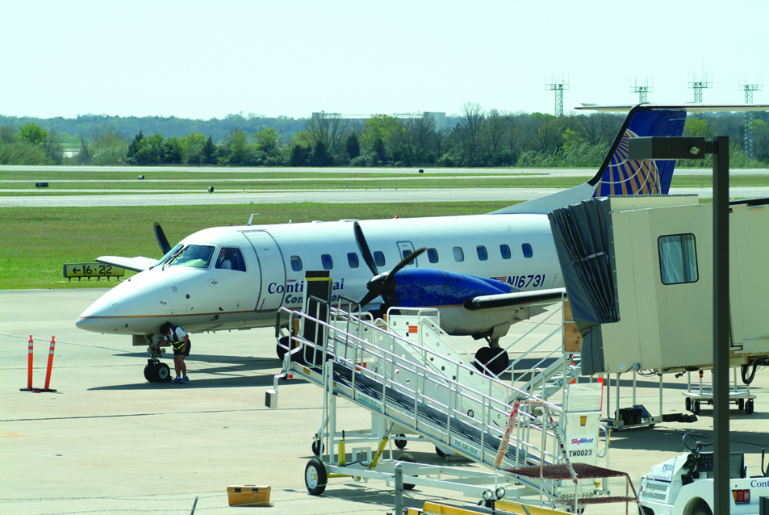
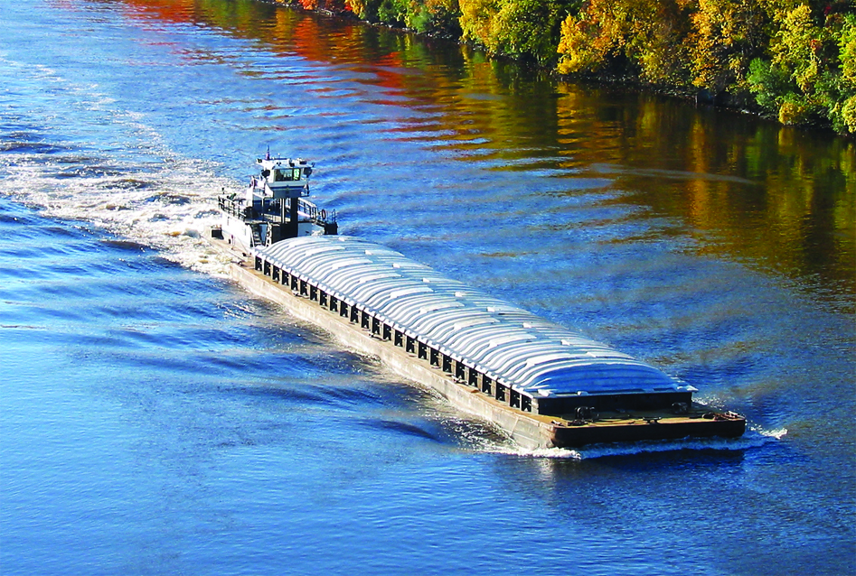
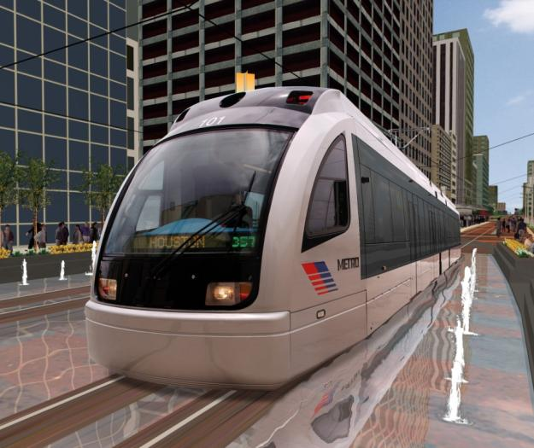
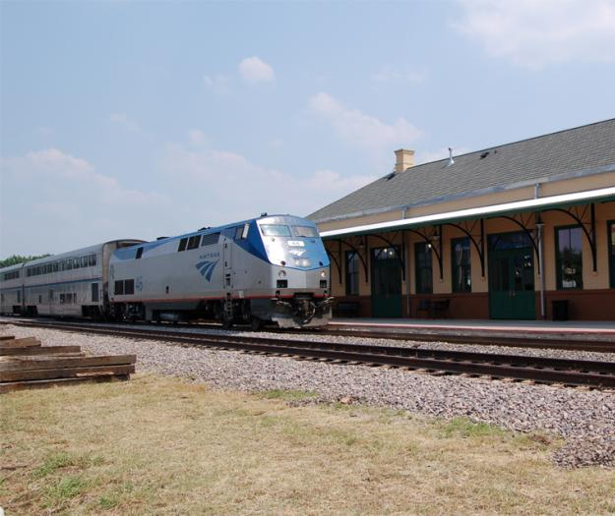
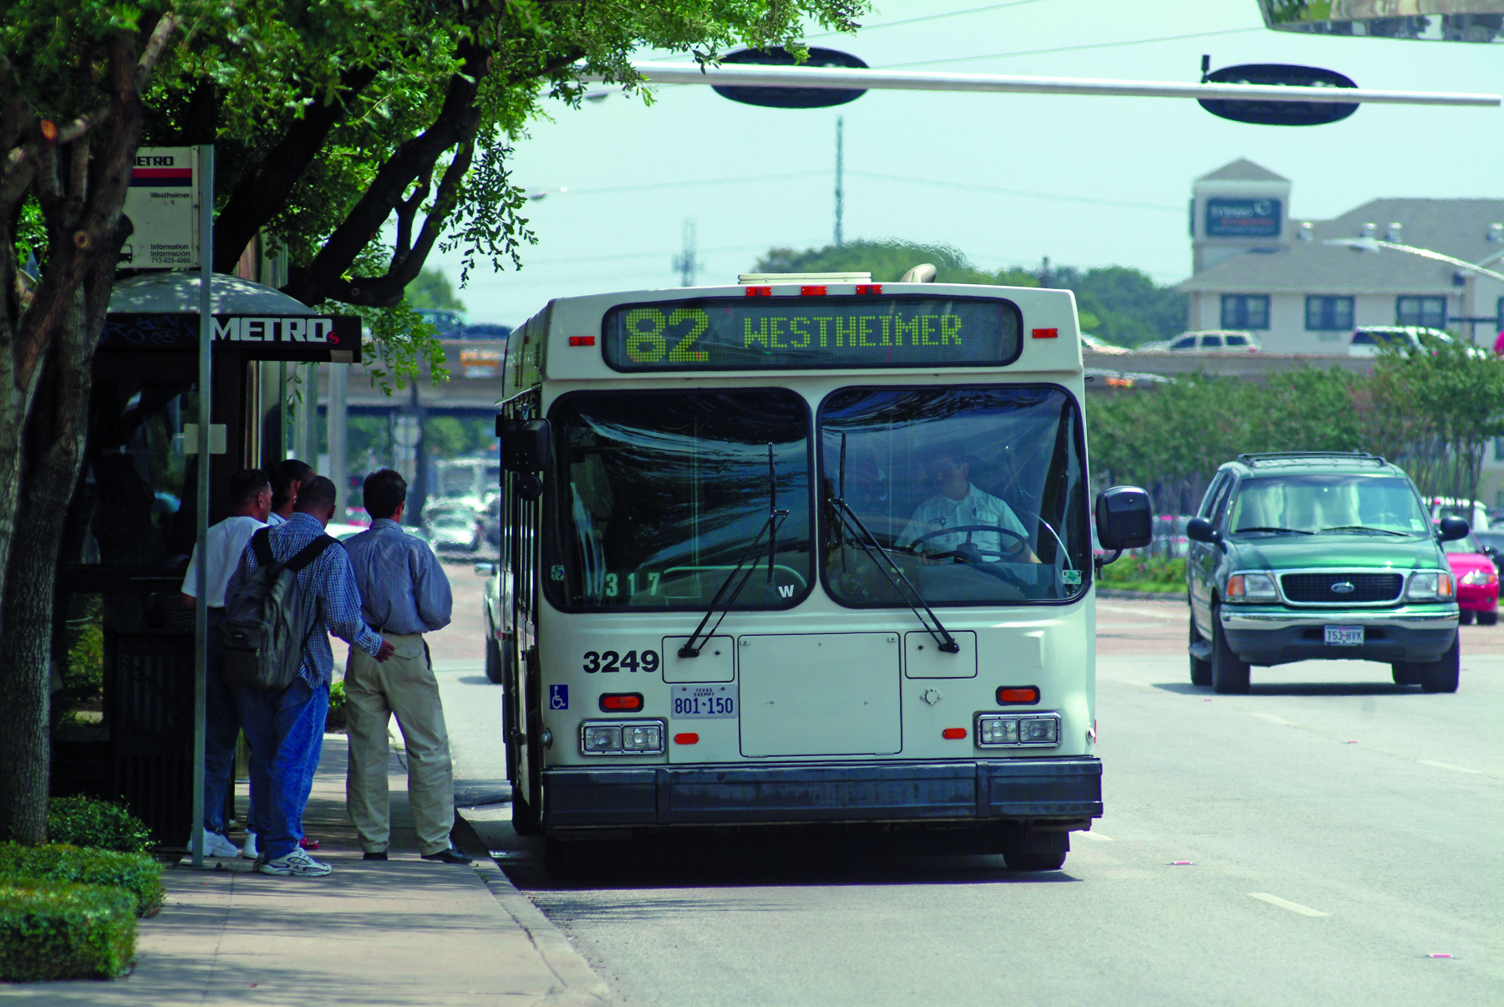
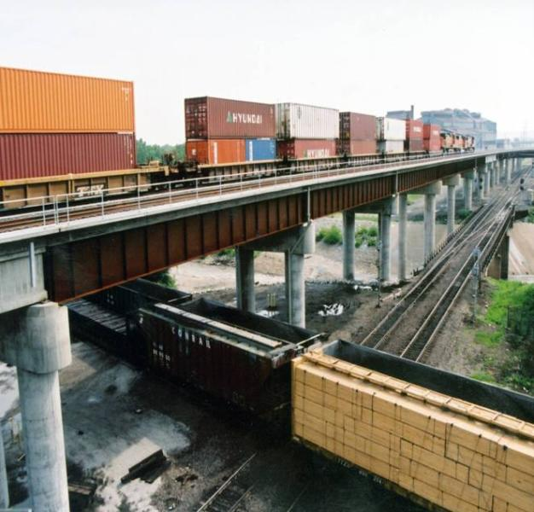
2030 Committee Scope
Comprehensive update on the mobility and maintenance needs of Texas
Maintenance: pavements and bridges
Mobility: urban and rural
Overview other transportation needs, especially potential for Texas’ relying increasingly on non-highway modes

Slide 5
Key Questions
Infrastructure goals?
Level of investment needed from all sources?
Infrastructure (bridges, pavements)
Mobility and safety (urban, rural)
Effects of alternative investment levels?
Strategic relationships with other modes? (public transportation, freight rail, intercity passenger rail, ports and waterways, airports)

Slide 6
Committee Goals
Preserve and enhance the value of the state’s enormous investment in transportation infrastructure
Preserve and enhance urban and rural mobility and their value to the economic competitiveness of Texas
Enhance the safety of Texas’ traveling public
Initiate a discussion on strategic rebalancing of transportation investments to anticipate future capacity restraints and mobility needs

Slide 7
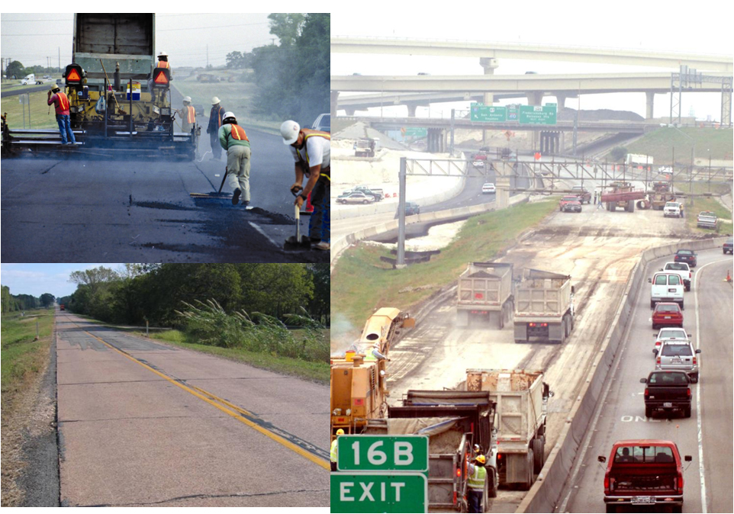
Committee Recommendations - Pavements
Preserve asset value of all pavements - maintain 90% “Good” or better pavement condition goal
Establish statewide system to forecast pavement maintenance and priorities
Investment needed = | $89 Billion Total
 | $4.0 Billion Annually

Slide 8
90% “Good” or Better Goal Total and Annual Needs

Slide 9
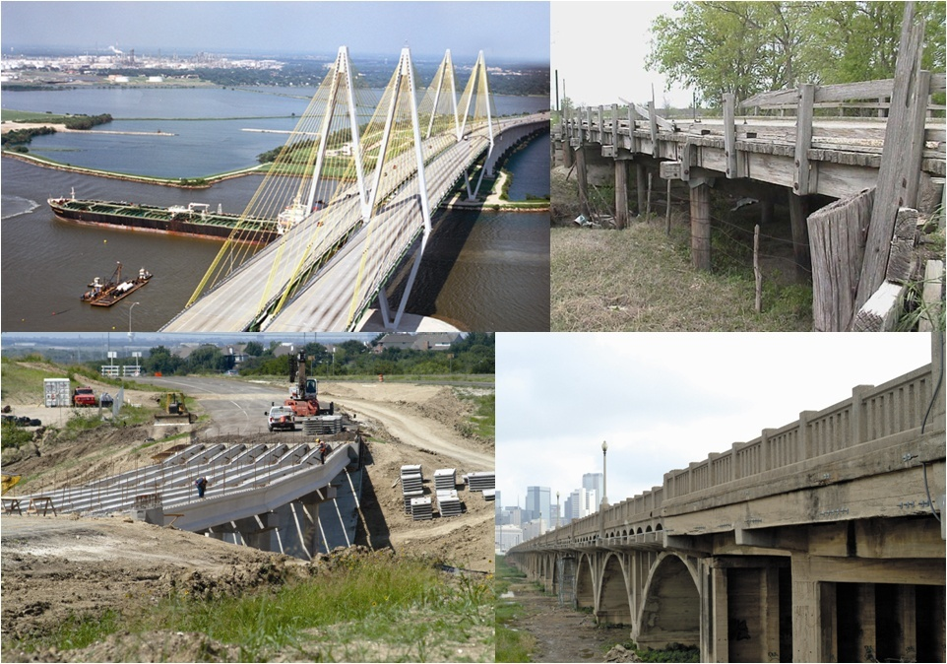
Committee Recommendations - Bridges
Replace on-system structurally deficient and sub-standard for load only bridges by 2012
Replace remaining structurally deficient, sub-standard for load only, and functionally obsolete bridges by 2030
Increase inspection and maintenance activities
Maintain safety
Extend life
Investment needed = | $36 Billion Total
 | $1.6 Billion Annually

Slide 10
Bridge Replacement, Maintenance and Inspection Costs (Billions 2008 $)
Bridge Type | Replacement | Maintenance | Inspection | Total Cost
On-System | $ 19.9 | $ 1.1 | $ 0.6 | $ 21.6
Off-System | $ 7.8 | * | $ 0.3 | $ 8.1
Mobility | ** | $ 0.1 | $ 0.2 | $ 0.3
Special & Large | $ 6.1 | *** | *** | $ 6.1
Total Costs | $ 33.8 | $ 1.2 | $1.1 | $36.1
* Funded by cities and counties ** New bridges built as a result of mobility needs *** Special and large bridge maintenance costs included in on-system category

Slide 11
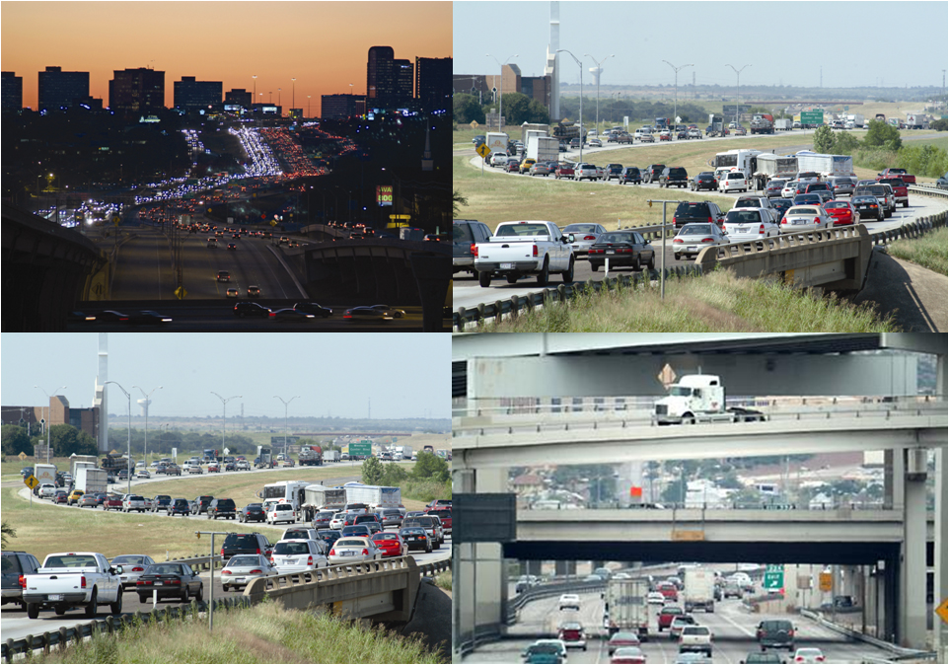
Committee Recommendations – Urban Mobility
Prevent worsening congestion; do not allow Texas’ urban mobility to decline below the average of peer cities
Broaden ability of urban regions to raise revenue to increase mobility if locally desired without reducing state funding for mobility
Investment needed = | $171 Billion Total
 | $7.8 Billion Annually

Slide 12
Mobility Scenario Comparisons
Reduce Congestion
Cost (billions of $2008)
Prevent Worsening
Congestion
RECOMMENDATION
Maintain
Economic Competitiveness
MINIMUM
Current Funding Trend
Inadequate Mobility Investment

Slide 13
Mobility Scenario Comparisons
Reduce Congestion
= Historic State Share
Cost (billions of $2008)
Prevent Worsening
Congestion
RECOMMENDATION
Maintain
Economic Competitiveness
MINIMUM
Current Funding Trend
Inadequate Mobility Investment

Slide 14
Scenario Implementation and Congestion Costs
Current Funding
Trend
Maintain Economic
Competitiveness
Prevent Worsening Congestion
Reduce Congestion

Slide 15
Benefits and Costs of Urban Scenario Investments in 2030 (Billions 2008 $)
Current Funding
Trend
Maintain Economic
Competitiveness
Prevent Worsening Congestion
Reduce Congestion

Slide 16
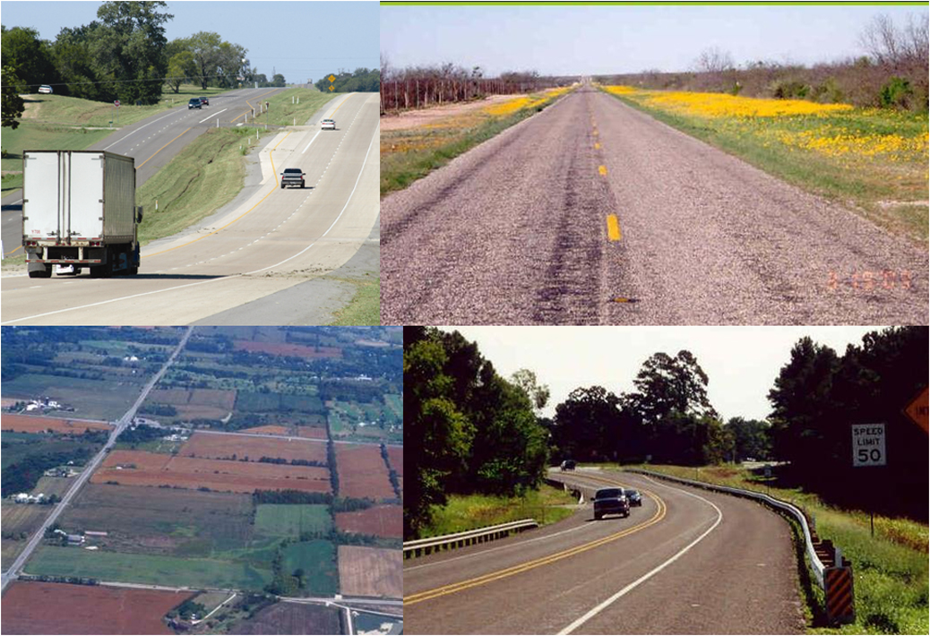
Committee Recommendations – Rural Mobility and Safety
Complete Texas Trunk System
Facilitate rural competitiveness
Safety
Prioritize additional road capacity for highest immediate economic impact
Investment needed = | $17 Billion Total
 | $0.8 Billion Annually

Slide 17
Benefits and Costs of Rural Scenario Investments in 2030 (Billions 2008 $)
Congestion and Safety
Congestion and Safety + Partial Connectivity
Congestion and Safety + Full Connectivity

Slide 18
Total Investment Needed (2008 $)
 | 2009 - 2030 | Per Year
Pavements | $ 89 Billion | $ 4.0 Billion
Bridges | $ 36 Billion | $ 1.6 Billion
Urban Mobility | $ 171 Billion | $ 7.8 Billion
Rural Mobility/Safety | $ 17 Billion | $ 0.8 Billion
TOTAL | $ 313 Billion | $14.2 Billion

Slide 19
Total and State Investment Needed (Billions 2008 $)
 | Needs 2009 - 2030 |  |  | Annual Investment
 | Total |  | State Investment | Total |  | State Investment
Pavements | $ 89 |  | $ 89 | $ 4.0 |  | $ 4.0
Bridges | $ 36 |  | $ 36 | $ 1.6 |  | $ 1.6
Urban Mobility | $ 171 | * | $ 106 | $ 7.8 | * | $ 4.8
Rural Mobility/Safety | $ 17 |  | $ 17 | $ 0.8 |  | $ 0.8
TOTAL | $ 313 |  | $248 | $14.2 |  | $11.2
* Historically about 2/3 of Urban Mobility has been State responsibility, 1/3 local

Slide 20
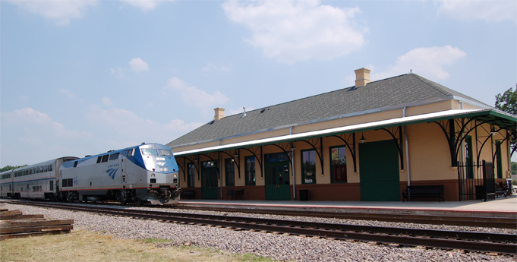
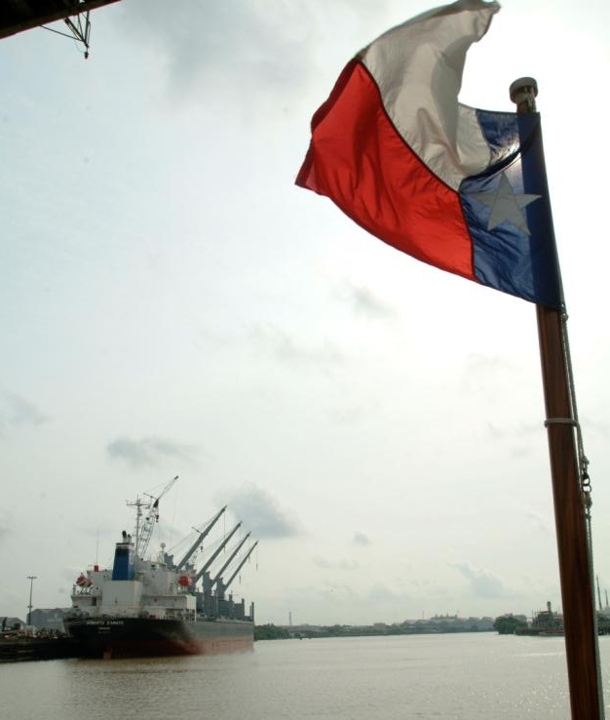
Other Transportation Modes for 2030
The state’s role warrants further study beyond current scope of the 2030 Committee

Slide 21
Public Transportation
Perform a comprehensive examination of federal, state and local partnerships to meet regional needs through coordination of funding and services

Slide 22
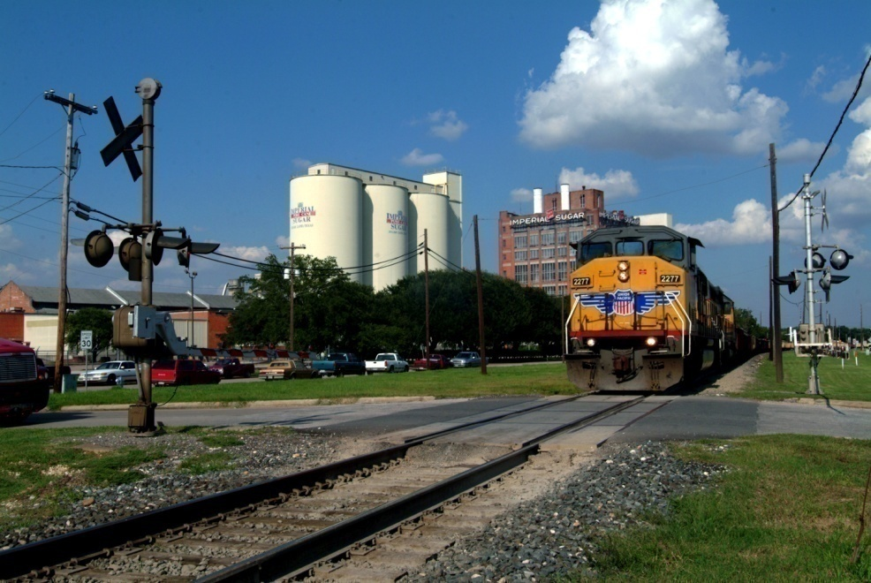
Freight Rail
Maintain prudent regulatory policy
Continue TxDOT initiatives
Continue analysis of public/private potential

Slide 23
Intercity Passenger Rail
Conduct comprehensive examination of conventional and high-speed rail alternatives
Committee of representative stakeholders
Recommendations in 2010

Slide 24
Ports and Waterways
Monitor adequacy of federal and state funding to meet security requirements
Monitor federal and state funding to provide adequate connecting transportation infrastructure to ensure a significant contribution to Texas’ economic competitiveness

Slide 25
Airports
Monitor adequacy of federal and state funding to ensure a significant contribution to economic competitiveness

Slide 26
QUESTIONS?

